Slide 1
Bitcoin Digital Currency for the 21st Century
Nick Kamper
Mike McDonald
Ryan Oliver
Stephen Shinn

Slide 2
Bitcoin Background
Created in 2008 by “Satoshi Nakamoto”
First client operated in January 2009
Electronic cash system
Private
Peer to Peer
Decentralized
“...computationally impractical to reverse” [1]
Notes:
Satoshi is a pseudonym, nobody really knows who he/she/they are
Bitcoin clients are entirely open source
Implemented on everything from servers to FPGA’s
Privacy: Everyone has an address, therefore they are “anonymous”
Peer to Peer: transfer goes from one person directly through another, no “bank” required
Decentralized: Nobody is regulating the currency (unlike the Federal Reserve for the USD)
Cryptographically Secure: As long as there are more honest nodes in the network, it will work
[1] http://bitcoin.org/bitcoin.pdf

Slide 3
Hashcash: The Basis of Bitcoin
First proposed in 1997 by Adam Back
Designed to limit spam emails and DoS attacks
Requires a “Proof of Work” or POW
Very easy for a single email
Very difficult for large numbers of emails
Notes:
Prepare an email header
Append a random number
SHA-1 it, see if it has the correct number of leading zero’s
If it does, we’re done
Otherwise, we need to increment the number and try again until we succeed
This takes about 1 second for 20 leading zero’s
POW is also called challenge/response, since the system challenges the user for a response before granting a service
Other POW’s include: integer square root mod p, diffie-hellman type problems
http://en.wikipedia.org/wiki/Proof-of-work_system

Slide 4
What is a Bitcoin?
A Bitcoin is a chain of hashed Elliptic Curve Digital Signatures
These signatures can be transferred to different addresses
Stored in a “wallet,” which enables and logs transactions
Notes:
A Bitcoin address is nothing more than an individuals public key
Bitcoin wallets store the users private key, which allow transfer

Slide 5
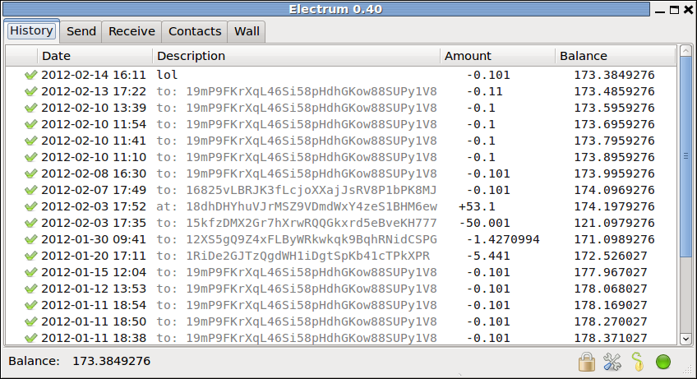
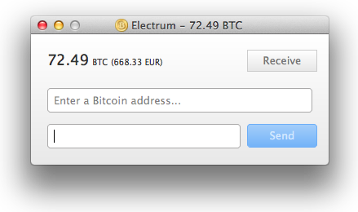
Example Bitcoin Wallet

Slide 6
Bitcoin Transactions
Over the last 30 days:
4.2 million BTC
455 million USD
Two problems associated with Bitcoin transfer
Verification
Double Spending Prevention
Notes:
On one exchange, close to half a billion USD traded
Verification: How do you know the coin in valid?
Double spending: How do you prevent someone who gave you a coin from spending it themselves?

Slide 7
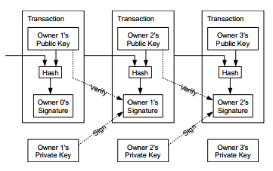
Bitcoin Transaction Procedure
Bitcoins are sent to the new address
Coin is verified by new owner
Ensure it hasn’t been spent already
Coin is signed by new owner
Ensure the old owner can’t spend it again
Notes:
http://en.wikipedia.org/wiki/File:Bitcoin_Transaction_Visual.png

Slide 8
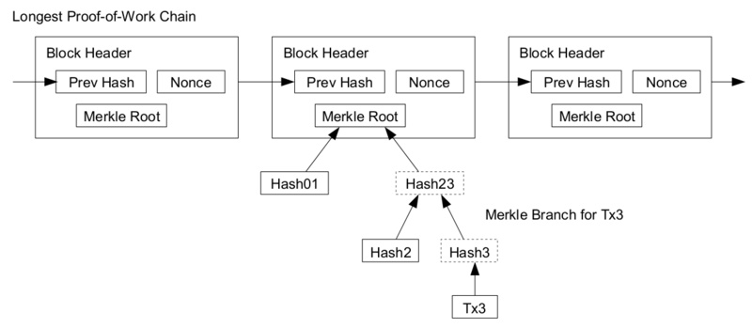
Verification
Only reliable as long as the network is controlled by honest nodes, that is, the longest chain is valid
Notes:
http://en.wikipedia.org/wiki/File:Bitcoinpaymentverification.png

Slide 9
Double Spending

Slide 10
Bitcoin Mining Overview
Companies expend time and energy, as well as money on technological tools and physical space to extract precious resources from the earth
Bitcoin miners expend time and electricity solving POW problems to validate the Bitcoin blocks, securing the transactions and providing value

Slide 11
Bitcoin Mining
Virtual scarcity of Bitcoins
Controlled inflation leads to stability in the currency
Modeled after precious metals
This scarcity is regulated by the difficulty of solving POW’s
Solving a POW for a given block gives 25 BTC + transaction fees
Notes:
The POW is similar to Hashcash:
Bitcoin uses SHA-2 instead of SHA-1, because they figured that SHA-1 would be broken soon.
The number of leading zero’s changes based on the difficulty: more 0’s -> longer to find the POW, meaning fewer Bitcoins are mined
But I thought you said it was “deregulated”
It is: nothing is controlling this other than the people mining
More people mining -> harder to get bitcoins
Bitcoin output is roughly proportional to input

Slide 12
Mining Hardware
CPU’s were first
GPU’s are faster, more expensive, and power hungry
FPGA’s are even faster, but more expensive than GPU’s, harder to program, and not much more power efficient
ASIC’s are the fastest, but also the most expensive (by a long shot)
Notes:
CPU’s: anyone can do
GPU’s: anyone with a semi decent GPU can do
FPGA’s: require special hardware that most people don’t have
ASIC’s: serious hardware necessary to manufacture them, just coming on the market, significantly more expensive

Slide 13
What makes Bitcoin secure?
More honest nodes than dishonest nodes
Dishonest nodes have to rebuild the entire chain, back to when the coin was first mined
Transaction chain is made public
Longest chain is the valid chain

Slide 14
Bitcoin Today
1BTC is $107, on MTGOX
Currently unregulated (for individuals) by US DoT

